Slide 1
GROUP 18
Aleksandra Kondracka
Thomas Cherry
Xiaofei Guo
Yi Luan
Kanlin Cheng
James Steeper
Notes:
intro - Tom
brief intro - say names

Slide 2
IBM & AI
Turing Test – Could a computer imitate a human?
Fascinating to see how fast AI is developing
Makes decision making quicker as well as more efficient
Korean Air – IBM
Watson
Locates previously hidden connections
Real-time analysis
Maintenance cases addressed 90% faster

Slide 3
SKILLS
Web-creation
Multimedia Experience
Java Programming
Agile Development
Trello
Willing to use cloud development tools
Constant communication

Slide 4
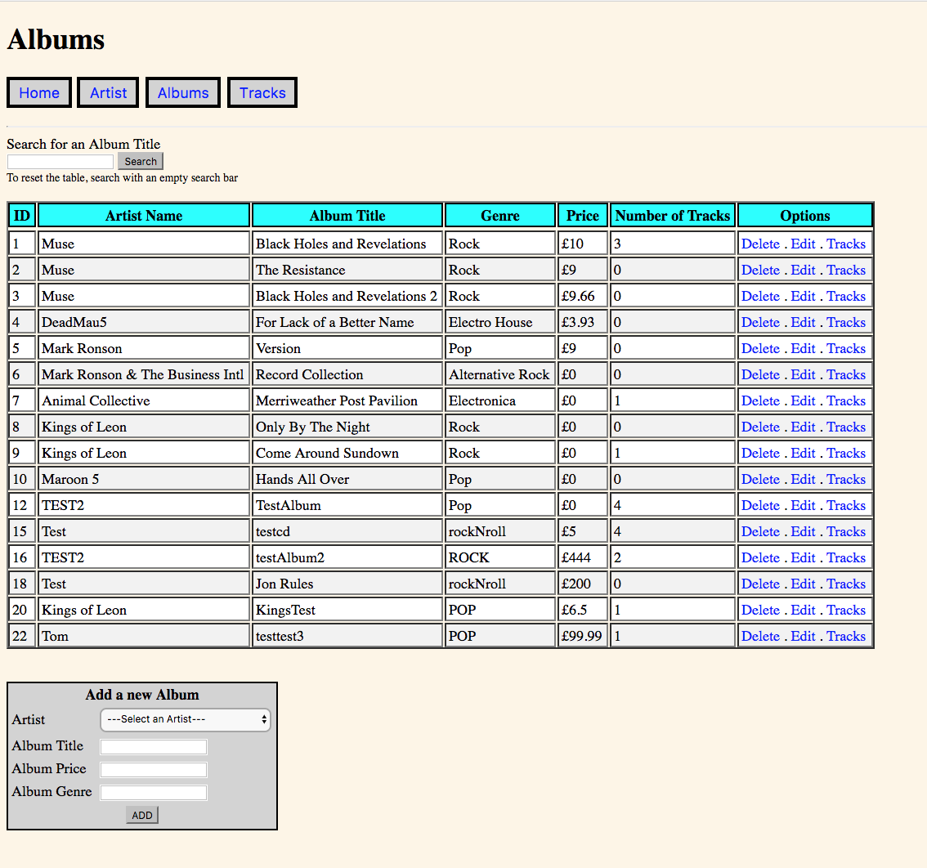
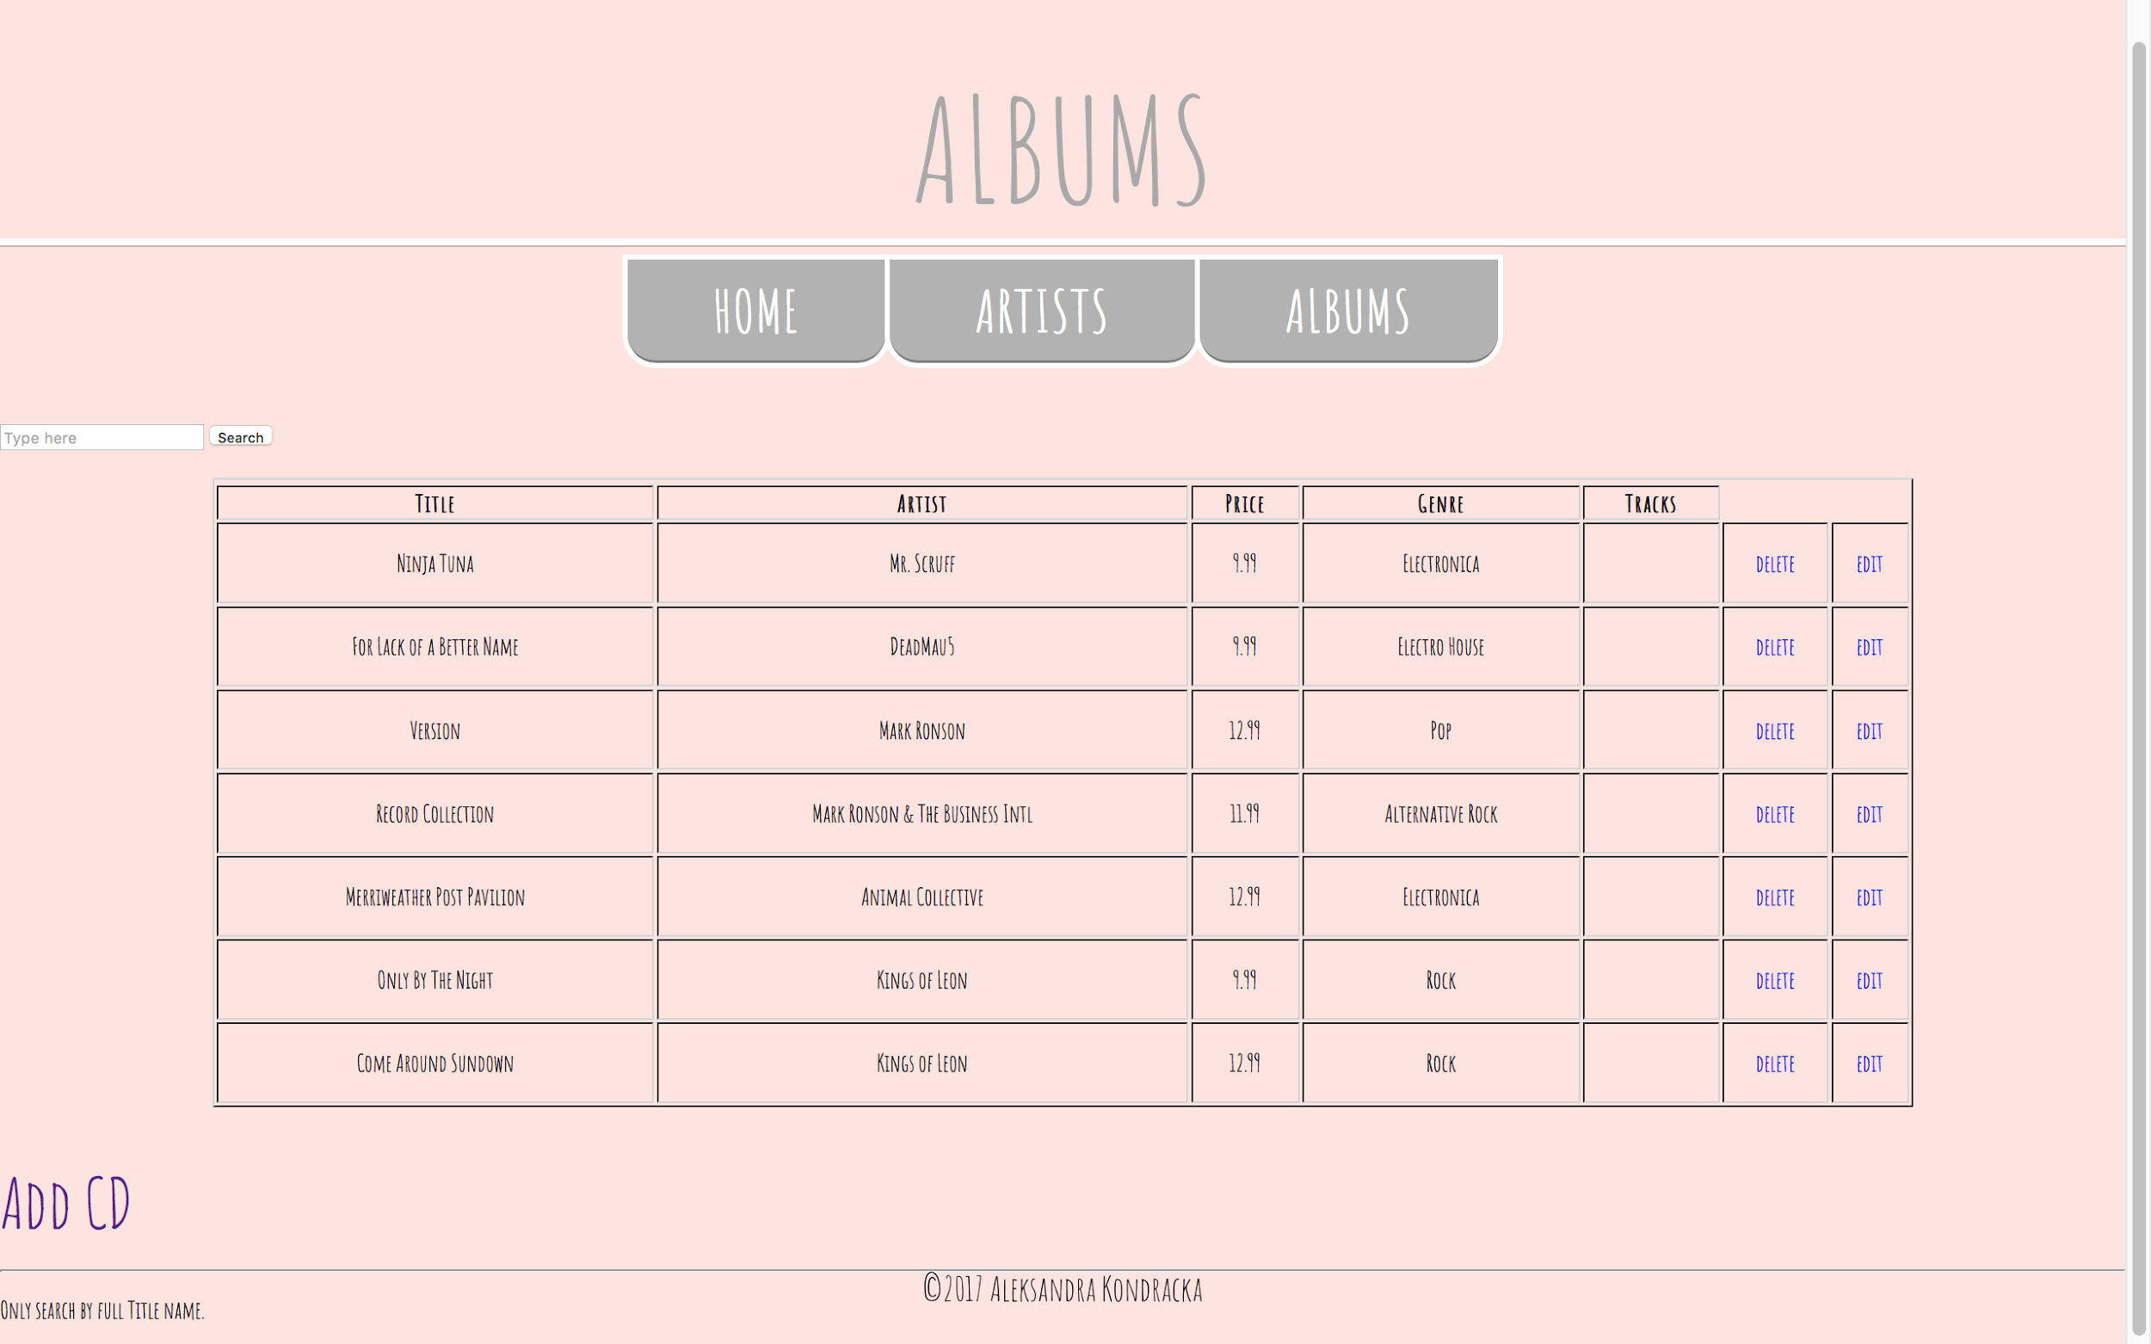

Slide 5
SKILLS
Web-creation
Multimedia Experience
Java Programming
Agile Development
Trello
Willing to use cloud development tools
Constant communication

Slide 6
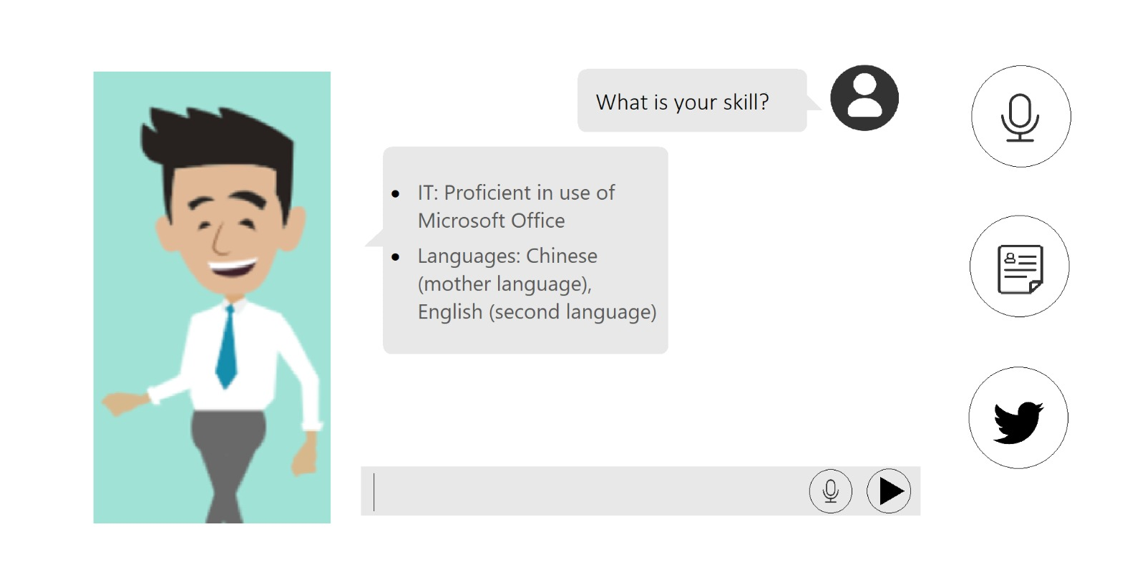
Guide the employer to obtain information

Slide 7
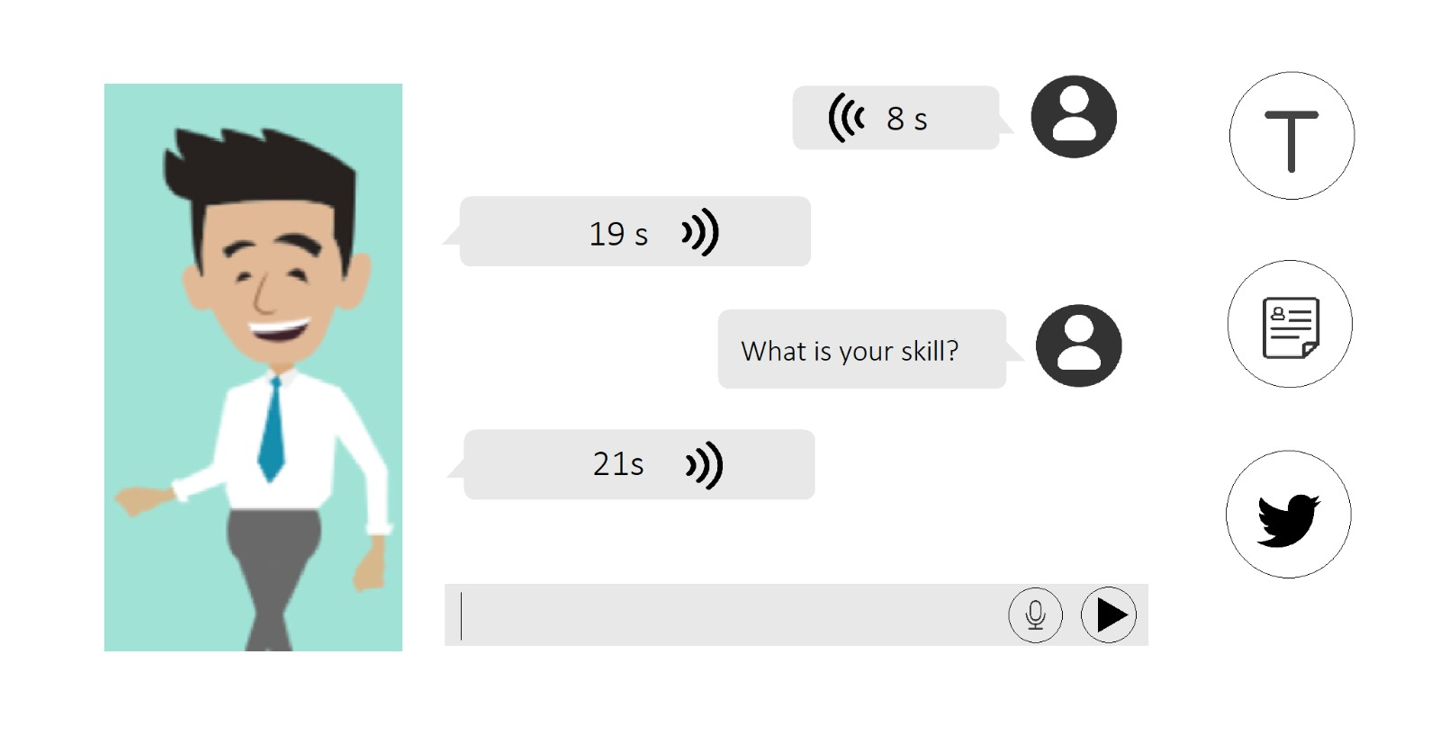
Speech to text / Text to speech freely

Slide 8
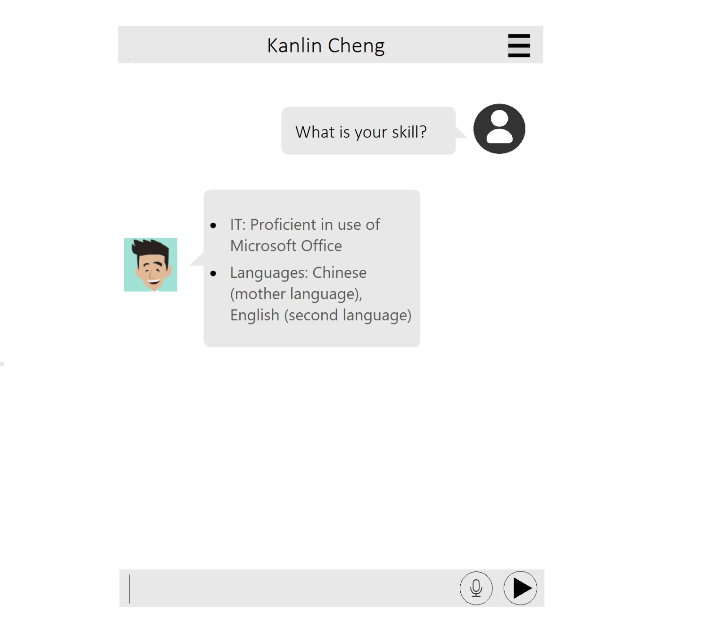
Watson dialogue can also be applied on an app

Slide 9
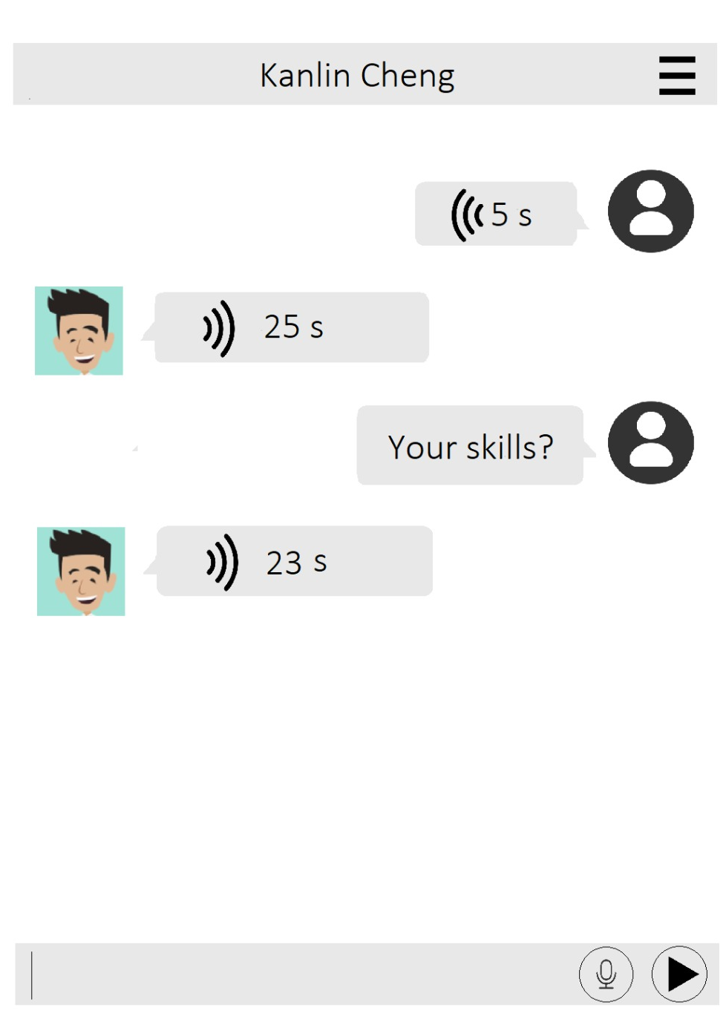
Watson dialogue can also be applied on an app

Slide 10
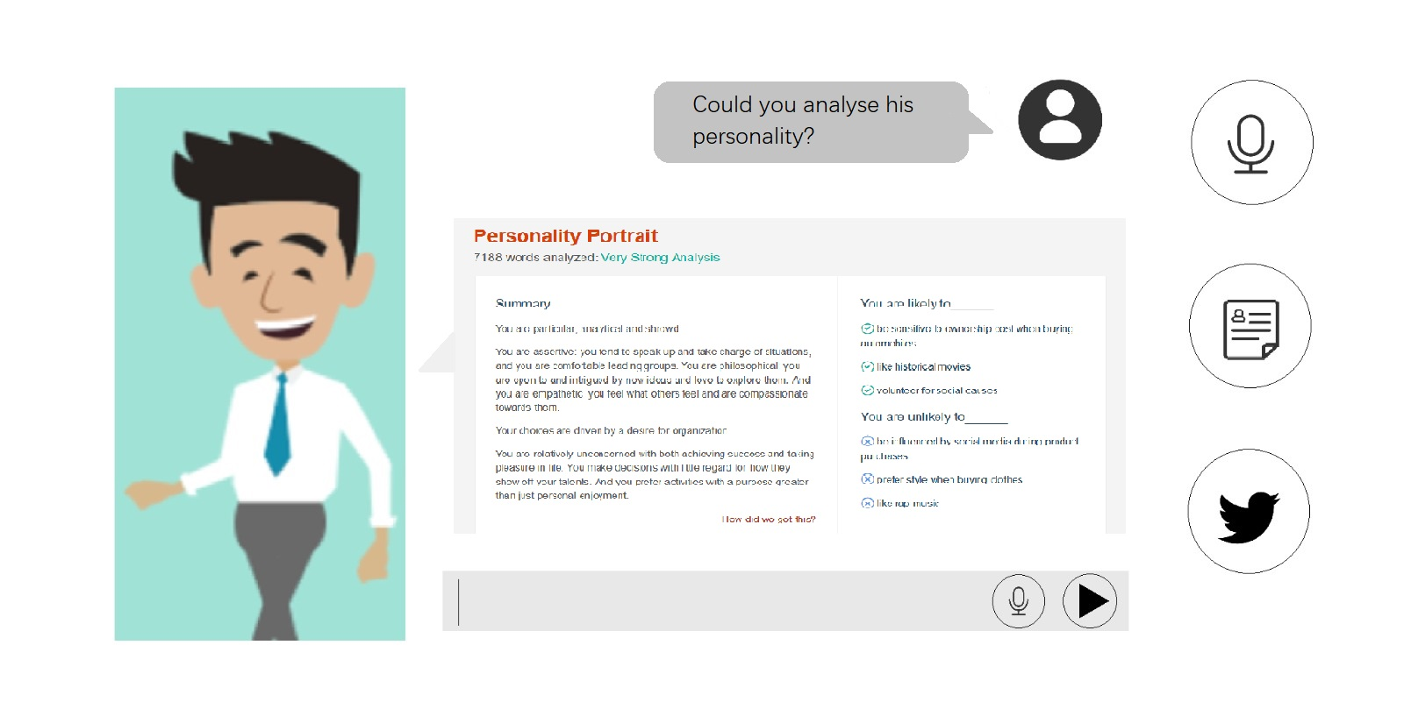
Personality insight service can help employers know about the owner more comprehensively

Slide 11
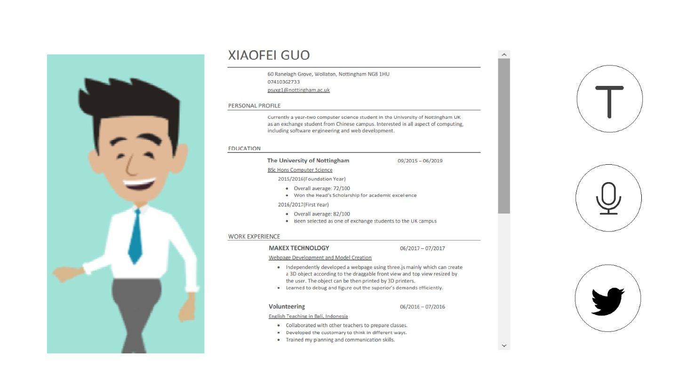
Browse the whole resume (on a webpage)

Slide 12
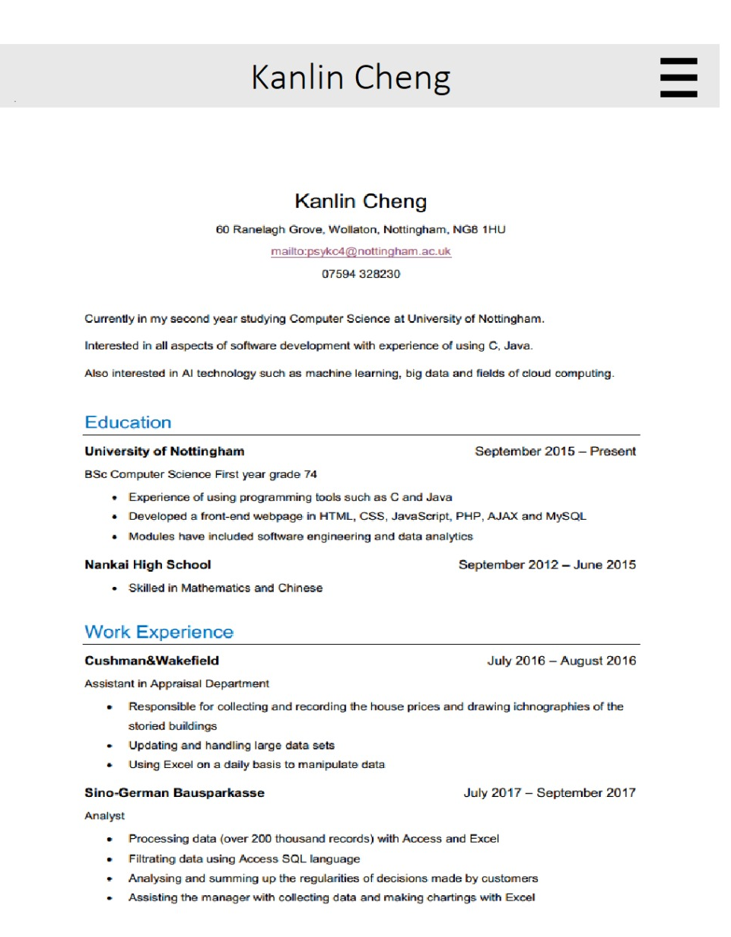
Browse the whole resume (on an app)

Slide 13
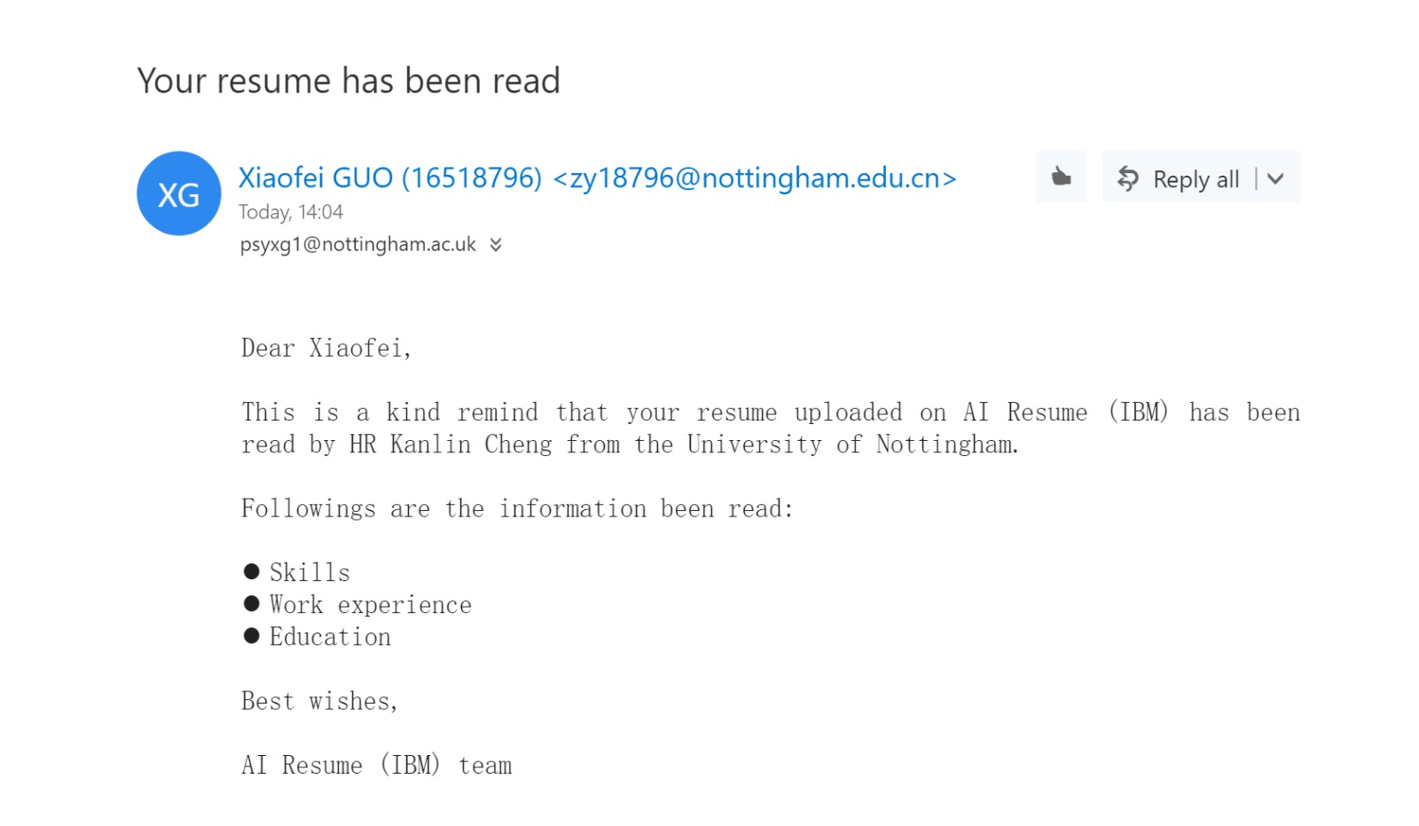
The resume owner will be sent an email if his/her resume is checked

